Slide 1
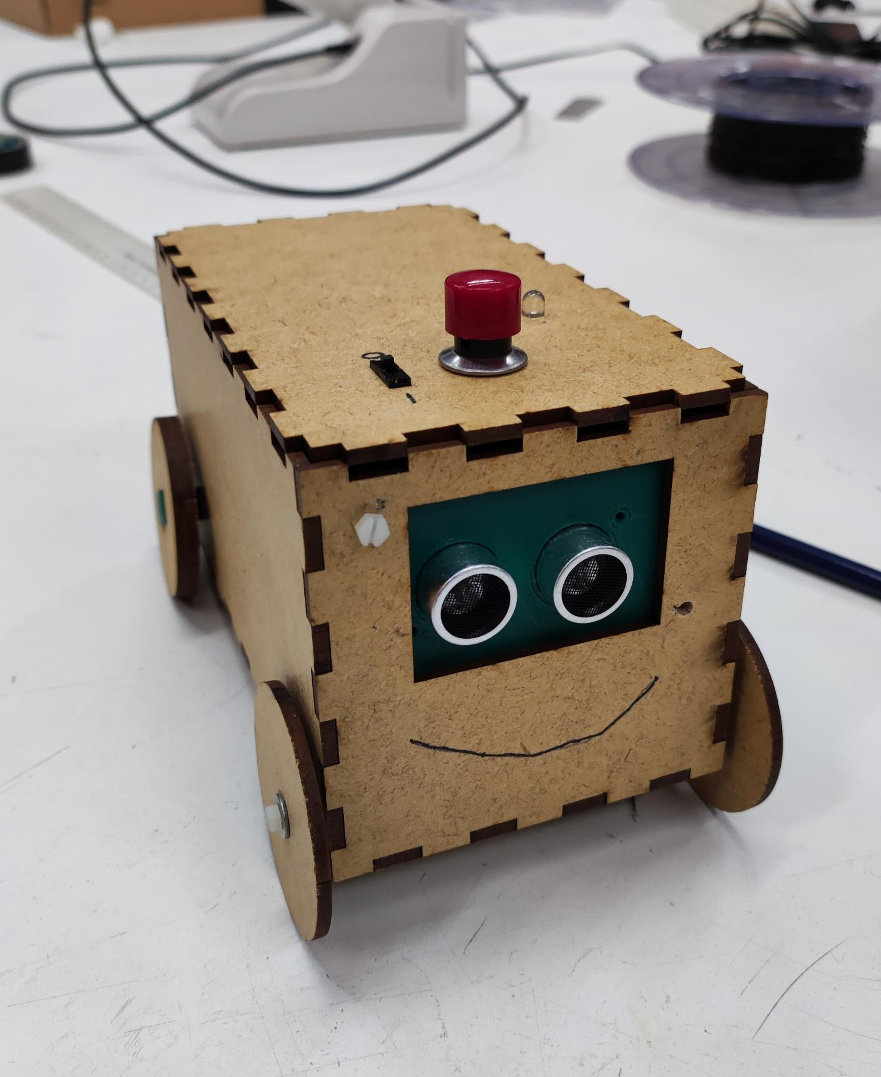
Group 14
alarmclock car

Slide 2
Summary of the project
Goal was to create a box that has four wheels, starts driving after delay set by user, stops in front of an obstacle and beeps
How it works:
Pressing the button increases the timer by 1 second. This can be changed in the code. The LED blinks when the button is pressed.
After the button is pressed enough times, the switch is flicked on. Then the LED blinks for as many times the button has been pressed.
The car start driving after the delay and the beeper beeps. Once it reaches an obstacle it stops 20cm in front of it and continues beeping.
To stop the beeping first flick the switch and then press the button again.

Slide 3
Parts
Box – lasercut MDF
Sensor bracket – 3D-printed
Axles – 3D-printed
Motor – zip tied
Batteries – zip tied
Buttons – on top
LED – on top
Others – hanging loose inside

Slide 4

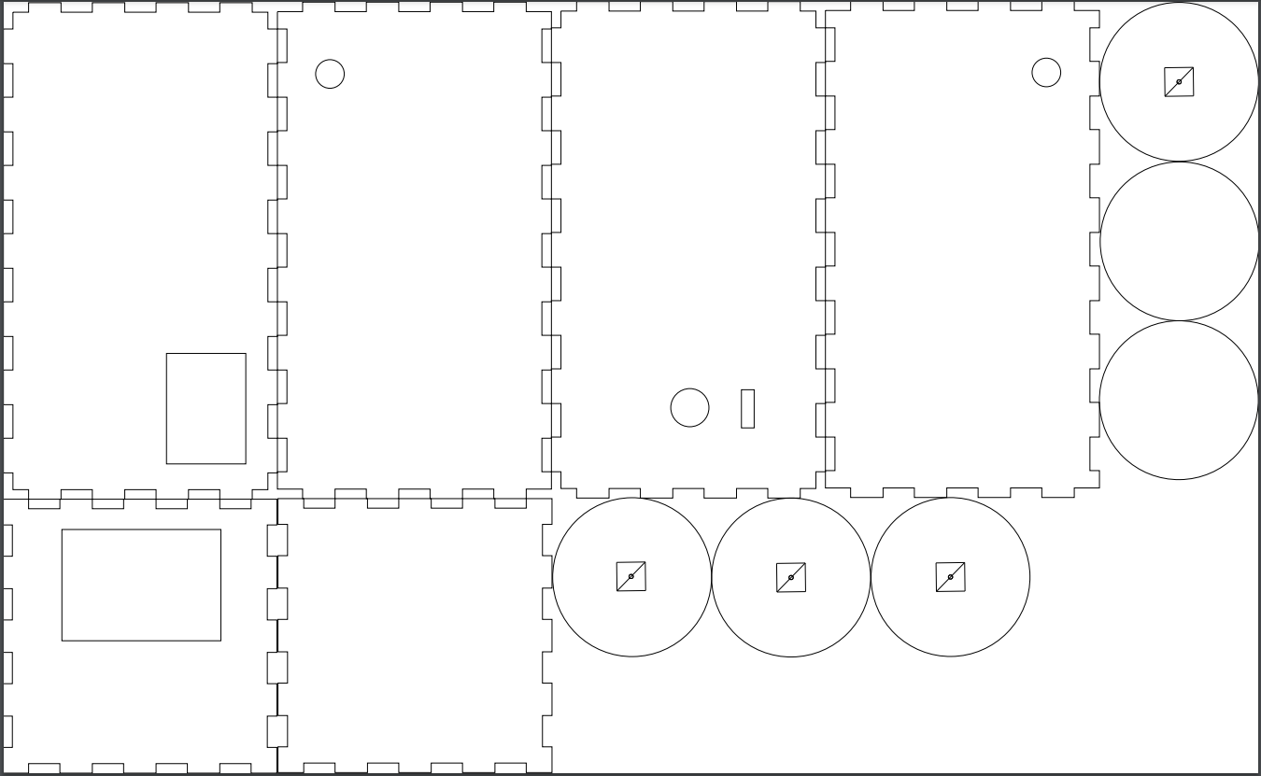
box

Slide 5
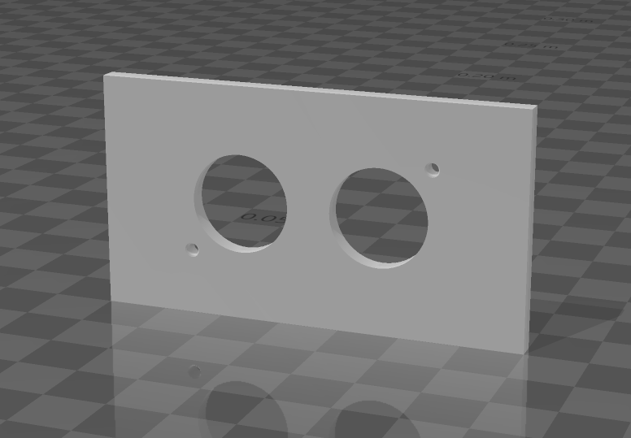
Sensor bracket

Slide 6
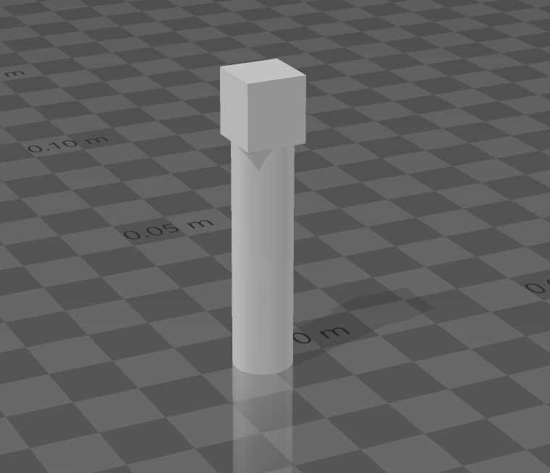
Axle

Slide 7
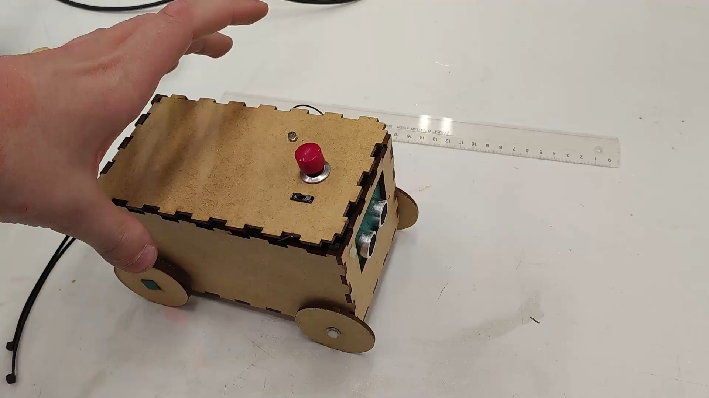
Video

Slide 8
Reflection
Result is better than what we expected for a 2 day build
Should have started earlier so it would not be a 2 day build
Finish could be a lot more polished had we started earlier
Good enough
Sustainability aspect is quite good
Easy to disassemble as nothing is glued
Only 2 wires are soldered
Components can be reused
Mainly MDF, 3 parts 3D-printed out of which 1 could be lasercut directly to the box
2 zip ties

Slide 9
Links
https://github.com/matiaspaavilainen/FabLab-Project14.git
https://www.digifab-oulu.com/wp-admin/edit.php

